Slide 1
AZ-900T00 Learning path 03: Management and governance
Notes:
https://learn.microsoft.com/training/paths/describe-azure-management-governance

Slide 2

Learning path 03―outline
You will learn the following concepts:
1
Cost management
Cost and pricing calculators
Cost management and tags
2
Governance and compliance
Blueprints, policies, and resource locks
Service Trust portal
3
Resource deployment tools
Portal, PowerShell, CLI, and others
Azure Arc and Azure Resource Manager
4
Monitoring tools
Azure Advisor, Azure Service Health, and Azure Monitor

Slide 3
Cost management
Notes:
https://learn.microsoft.com/training/modules/describe-cost-management-azure

Slide 4
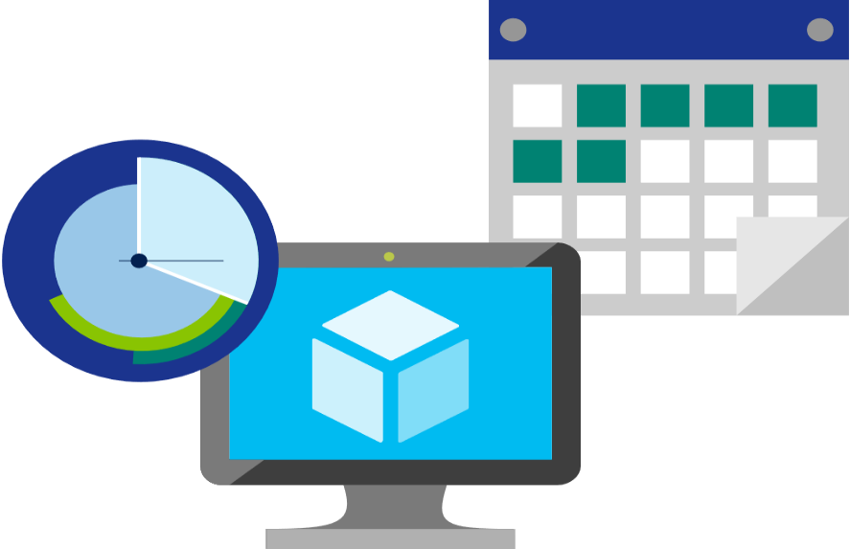
Factors affecting costs (part 1)
These are some of the factors affecting costs:
1) Resource type | 2) Consumption | 3) Maintenance
Costs are resource-specific, so the usage that a meter tracks and the number of meters associated with a resource, depend on the resource type. | With a pay-as-you-go model, consumption is one of the biggest drivers of costs. | Monitoring your Azure footprint and maintaining your environment can help you identify and mitigate costs that aren’t necessary, such as shutting down underused virtual machines.
Notes:
https://learn.microsoft.com/training/modules/describe-cost-management-azure/2-describe-factors-affect-costs-azure

Slide 5
Factors affecting costs (part 2)
These are some of the factors affecting costs:
4) Geography | 5) Network traffic | 6) Subscription
The same resource type can cost different amounts depending on the geographic area, which has an impact on Azure costs. | While some inbound data transfers are free, the cost for outbound data or data between Azure resources is impacted by billing zones. | The type and configuration of your subscription can also impact your cost. For example, the free trial lets you explore some Azure resources for free.
Notes:
https://learn.microsoft.com/training/modules/describe-cost-management-azure/2-describe-factors-affect-costs-azure

Slide 6

Explore Azure Marketplace
Azure Marketplace allows customers to find, try, purchase, and provision applications and services from hundreds of leading service providers, which are all certified to run on Azure.
Open-source container platforms.
Virtual machine and database images.
Application build and deployment software.
Developer tools.
And much more, with 10,000-plus listings!
Notes:
https://learn.microsoft.com/training/modules/describe-cost-management-azure/2-describe-factors-affect-costs-azure
Connects end users with Microsoft partners, Independent Software Vendors (ISVs), and start-ups that offer solutions and services for Azure.
Azure customers, IT professionals and cloud developers can find, try, purchase, and provision Azure applications and services from certified service providers.
Includes close to 10,000 product listings.
There is also a Marketplace FAQ available at https://azure.microsoft.com/en-us/marketplace/faq/
Azure Marketplace: https://azuremarketplace.microsoft.com/en-us/

Slide 7
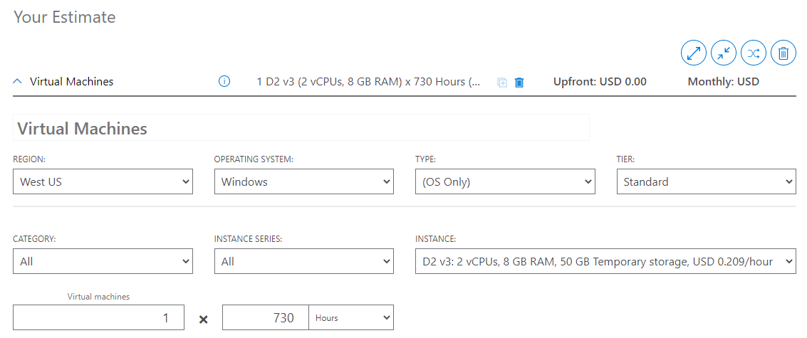
Pricing calculator
The pricing calculator is a tool that helps you estimate the cost of Azure products. The options that you can configure in the pricing calculator vary between products, but basic configuration options include:
Region
Tier
Billing options
Support options
Programs and offers
Azure dev/test pricing
Notes:
https://learn.microsoft.com/training/modules/describe-cost-management-azure/3-compare-pricing-total-cost-of-ownership-calculators
Pricing calculator: https://azure.microsoft.com/en-us/pricing/calculator/
Note: The pricing calculator provides estimates, and not actual price quotes. Actual prices can vary depending upon the date of purchase, the payment currency, and the type of Azure customer.

Slide 8
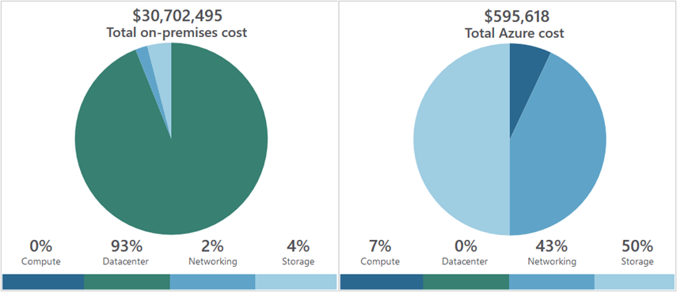
Total Cost of Ownership (TCO) calculator
A tool to estimate cost savings you can realize by migrating to Azure.
A report compares the costs of on-premises infrastructures with the costs of using Azure products and services in the cloud.
Notes:
https://learn.microsoft.com/training/modules/describe-cost-management-azure/3-compare-pricing-total-cost-of-ownership-calculators
TCO calculator: https://azure.microsoft.com/en-us/pricing/tco/calculator/

Slide 9
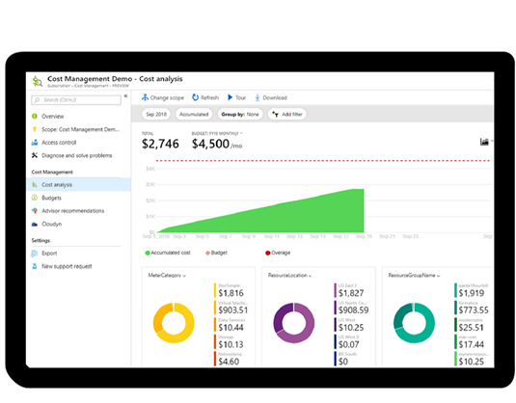
Azure Cost Management
Reporting: Billing reports
Data enrichment
Budgets: Set spend budget
Alerting: When cost exceed limits
Recommendation: Cost recommendations
Notes:
https://learn.microsoft.com/training/modules/describe-cost-management-azure/6-describe-azure-tool
Note: For more information about Cost Management, go to https://azure.microsoft.com/en-us/services/cost-management/

Slide 10


Tags
Provides metadata for your Azure resources.
Logically organizes resources into a taxonomy.
Consists of a name-value pair.
Very useful for rolling up billing information.
OR
owner: joe
department: marketing
environment: production
cost-center: marketing
Notes:
https://learn.microsoft.com/training/modules/describe-cost-management-azure/7-describe-purpose-of-tags
Tags: https://learn.microsoft.com/azure/azure-resource-manager/management/tag-resources

Slide 11
Governance and compliance
Notes:
https://learn.microsoft.com/training/modules/describe-features-tools-azure-for-governance-compliance

Slide 12

Azure Policy
Azure Policy helps to enforce organizational standards and to assess compliance at scale. Provides governance and resource consistency with regulatory compliance, security, cost, and management.
Evaluates and identifies Azure resources that do not comply with your policies.
Provides built-in policy and initiative definitions, under categories such as Storage, Networking, Compute, Security Center, and Monitoring.
Notes:
https://learn.microsoft.com/training/modules/describe-features-tools-azure-for-governance-compliance/3-describe-purpose-of-azure-policy
Azure Policy: https://azure.microsoft.com/en-us/services/azure-policy
Stay compliant with your corporate standards and service level agreements (SLAs) by using policy definitions to enforce rules and effects for your Azure resources.
Evaluates and identifies Azure resources that don’t comply with your policies.
Provides built-in policy and initiative definitions, under categories such as Storage, Networking, Compute, Security Center, and Monitoring.

Slide 13
Resource locks
Protect your Azure resources from accidental deletion or modification.
Manage locks at subscription, resource group, or individual resource levels within the Azure portal.
Lock Types | Read | Update | Delete
Delete | Yes | Yes | No
ReadOnly | Yes | No | No
Notes:
https://learn.microsoft.com/training/modules/describe-features-tools-azure-for-governance-compliance/4-describe-purpose-of-resource-locks
Resource Locks: https://learn.microsoft.com/azure/azure-resource-manager/resource-group-lock-resources

Slide 14
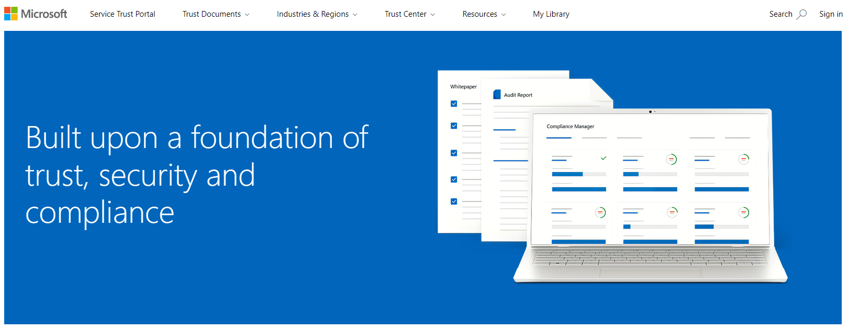
Service Trust portal
Notes:
https://learn.microsoft.com/training/modules/describe-features-tools-azure-for-governance-compliance/6-describe-purpose-of-service-trust-portal

Slide 15

Microsoft Purview
Microsoft Purview is a family of data governance, risk, and compliance solutions that helps you get a single, unified view into your data. Microsoft Purview brings insights about your on-premises, multicloud, and software as a service data together.
Automated data discovery
Sensitive data classification
End-to-end data lineage
Notes:
Azure Policy: https://learn.microsoft.com/en-us/purview/purview

Slide 16
Management and deployment tools
Notes:
https://learn.microsoft.com/training/modules/describe-features-tools-manage-deploy-azure-resources/

Slide 17




Tools for interacting with Azure
Azure portal
Azure PowerShell
Command-Line Interface (CLI)
Azure Cloud Shell
Notes:
https://learn.microsoft.com/training/modules/describe-features-tools-manage-deploy-azure-resources/2-describe-interacting-azure

Slide 18
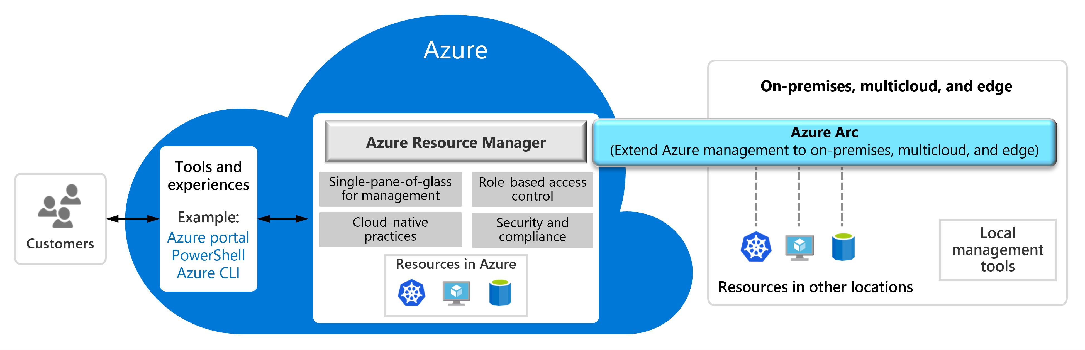
Azure Arc
Notes:
https://learn.microsoft.com/training/modules/describe-features-tools-manage-deploy-azure-resources/3-describe-purpose-of-azure-arc

Slide 19
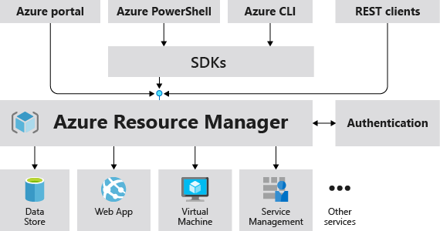
Azure Resource Manager
The Azure Resource Manager (ARM) provides a management layer that enables you to create, update, and delete resources in your Azure subscription.
Notes:
https://learn.microsoft.com/training/modules/describe-features-tools-manage-deploy-azure-resources/4-describe-azure-resource-manager-azure-arm-templates
Provides a management layer that enables you to create, update, and delete resources in your Azure subscription.
Create, configure, manage and delete resources and resource groups.
Organizes resources.
Controls access and resources.
Automates using different tools and SDKs.
Stores layouts in JSON files.
You can view more details about Azure Resource Manager at https://learn.microsoft.com/azure/azure-resource-manager/

Slide 20
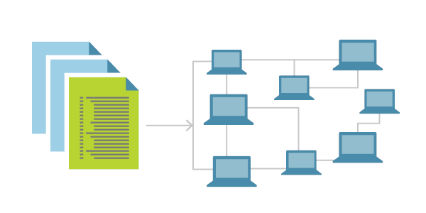
Infrastructure as code
Ensure consistency in deployment across your cloud ecosystem.
Manage configuration at scale.
Rapidly provision additional environments based on a standard configuration and build.
Notes:
https://learn.microsoft.com/en-us/devops/deliver/what-is-infrastructure-as-code#deploy-iac-on-azure

Slide 21
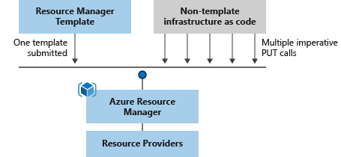
Azure Resource Manager (ARM) templates
Azure Resource Manager (ARM) templates are JavaScript Object Notation (JSON) files that can be used to create and deploy Azure infrastructure without having to write programing commands.
Declarative syntax
Repeatable results
Orchestration
Modular files
Built-in validation
Exportable code
Notes:
https://learn.microsoft.com/training/modules/describe-features-tools-manage-deploy-azure-resources/4-describe-azure-resource-manager-azure-arm-templates
https://learn.microsoft.com/azure/azure-resource-manager/management/overview
https://learn.microsoft.com/azure/azure-resource-manager/templates/overview
Deploy app resources Azure Resource Manager enables you to repeatedly deploy your app and have confidence your resources are deployed in a consistent state. You define the infrastructure and dependencies for your app in a single declarative template. This template is flexible enough to use for all of your environments such as test, staging or production. If you create a solution from the Azure Marketplace, the solution will automatically include a template that you can use for your app.
Organize resources
Azure Resource Manager makes it easy for you to manage and visualize resources in your app. You no longer have to deploy parts of your app separately and then manually stitch them together. You put resources with a common lifecycle into a resource group that can be deployed or deleted in a single action. You can see which resources are linked by a dependency. You can apply tags to resources to categorize them for management tasks, such as billing.
Control access to resources
With Azure Resource Manager, you can control who in your organization can perform actions on the resources. You manage permissions by defining roles and adding users or groups to the roles. For critical resources, you can apply an explicit lock that prevents users from deleting or modifying the resource. Azure Resource Manager logs all user actions so you can audit those actions. For each action, the audit log contains information about the user, time, events, and status.

Slide 22
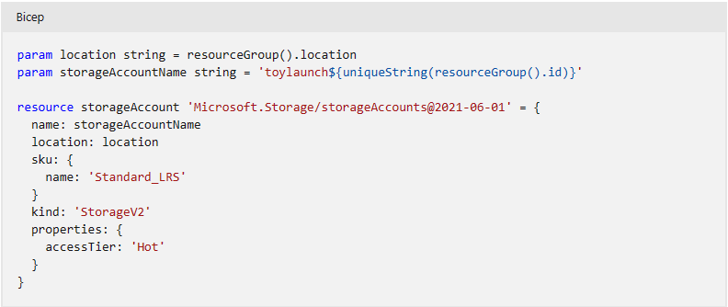
Bicep
Notes:
https://learn.microsoft.com/en-us/azure/azure-resource-manager/bicep/overview?tabs=bicep

Slide 23
Azure monitoring tools
Notes:
https://learn.microsoft.com/training/modules/describe-monitoring-tools-azure/

Slide 24

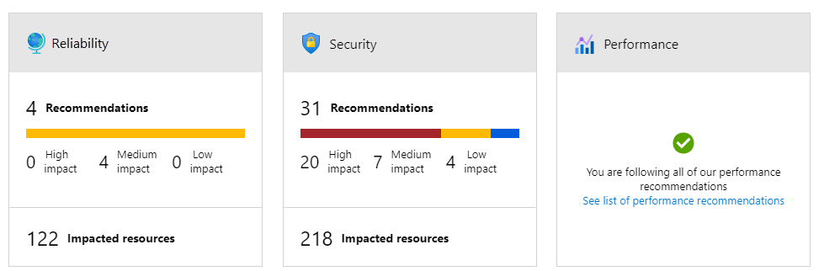
Azure Advisor
Azure Advisor analyzes deployed Azure resources and makes recommendations based on best practices to optimize Azure deployments.
Reliability
Security
Performance
Cost
Operational excellence
Notes:
https://learn.microsoft.com/training/modules/describe-monitoring-tools-azure/2-describe-purpose-of-azure-advisor
Get proactive, actionable, and personalized best practice recommendations.
Improve the performance, security, and availability of your resources.
Identify opportunities to reduce your Azure costs.
Azure Advisor - https://learn.microsoft.com/azure/advisor/advisor-overview

Slide 25

Azure Service Health
Azure Service Health is a collection of services that keep you informed of general Azure status, service status that may impact you, and specific resource status that is affecting you.
Azure Status: Global view of the health of all Azure services across all Azure regions.
Service Health: Focused view on only the services and regions that you’re using. If a service is experiencing a problem in a region you’re not using, it won’t show up here.
Resource Health: Tailored view of your actual Azure resources. It provides information about the health of your individual cloud resources.
Notes:
https://learn.microsoft.com/training/modules/describe-monitoring-tools-azure/3-describe-azure-service-health

Slide 26

Azure Monitor
Azure Monitor maximizes the availability and performance of applications and services by collecting, analyzing, and acting on telemetry from cloud and on-premises environments.
Application Insights
Log Analytics
Smart alerts
Automation actions
Customized dashboards
Notes:
https://learn.microsoft.com/training/modules/describe-monitoring-tools-azure/4-describe-azure-monitor

